Slide 1
Major ethics thinkers in history
COM 2290
Spring 2017

Slide 2
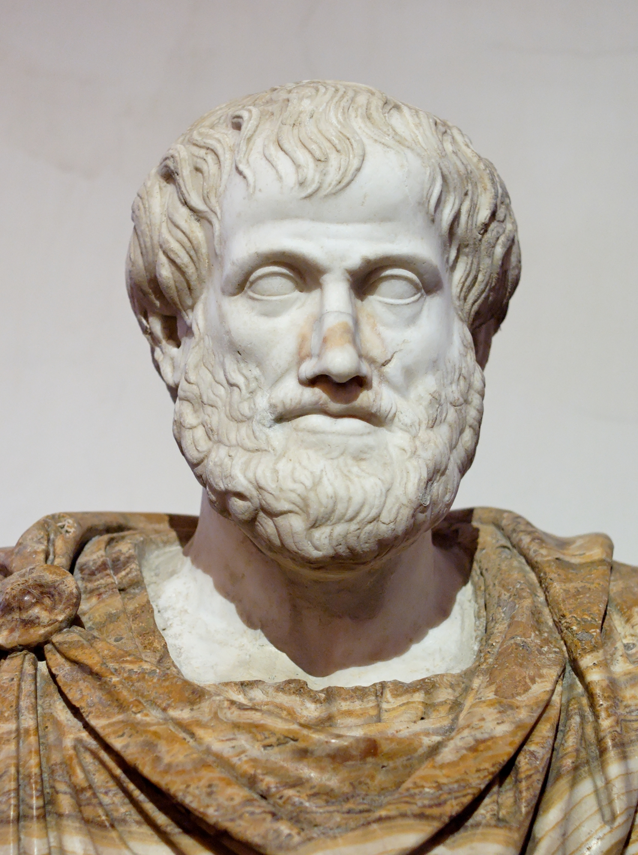
Leading ethics thinkers
Aristotle
Ancient Greek History (384-322 B.C.)
PlatO’s student
Tutored Alexander the great
Human goodness needs rationality
2 kinds of virtues: intellectual and moral (courage, truth, justice)
We have a capacity to flourish as humans to reach our potential
Behavior that undermines our potential is dangerous

Slide 3
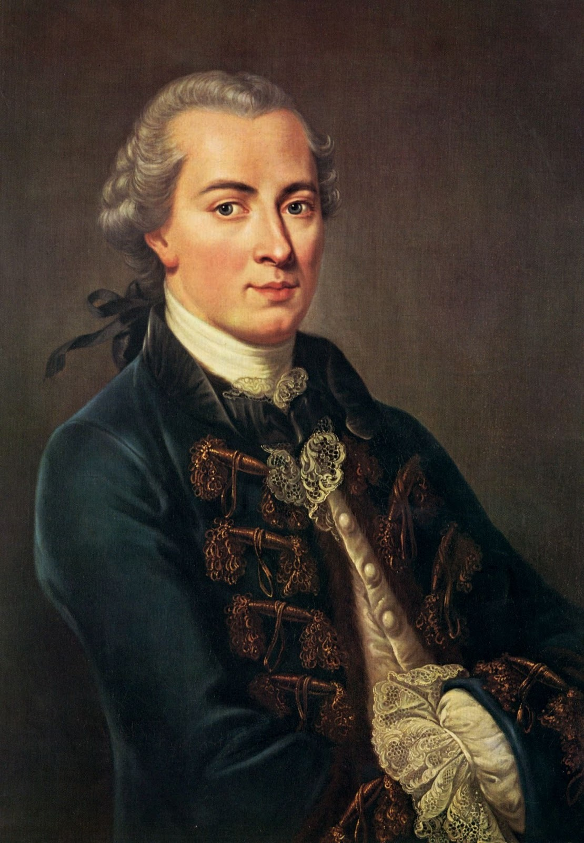
Leading ethics thinkers
Immanuel Kant
18th Century
We are moral agents
Rationality and liberty guide our decision making
Our moral decisions should be universalized-->applied by everyone as the standard decision
We treat each other with respect not use each other to get what we want

Slide 4
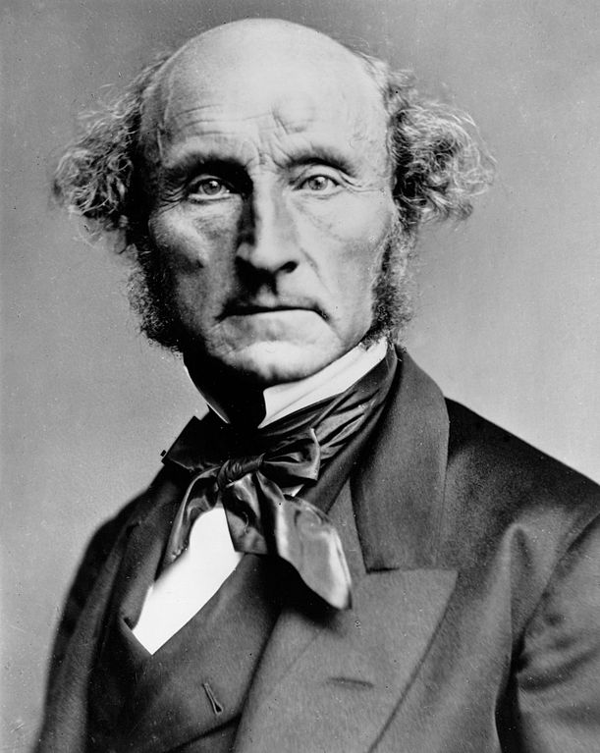
Leading ethics thinkers
John stuart mill
19th Century
Pleasure and moral goodness go together
Our actions should yield pleasure
Theory of utility→moral worth has consequences
We should choose actions that provide the greatest happiness AND benefits for society

Slide 5
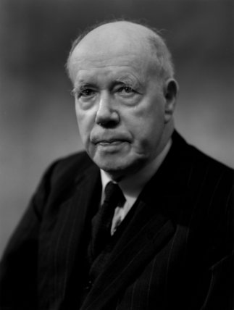
Leading ethics thinkers
W.D. Ross
Late 19th/Early 20th Century
Intuitionist: we have inherent abilities to recognize our moral duties
Ethics is about conflicting moral reasons to take or not take actions
We must honor several key values
Fidelity
Gratitude
Justice
Self improvement

Slide 6
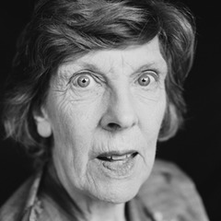
Leading ethics thinkers
Philippa Foot
20th Century
We need to minimize harm
Look to nature as guides
Humans should model their behavior in understanding harm similar to how mother nature knows harm
Compares humans with plants in knowing what harm can do
Vice is similar to a defective tree root or poor vision in an owl

Slide 7
Leading ethics thinkers
Idealism vs relativism
Idealism = how strongly we feel about pursuing goals and the welfare of humanity
Everyone’s well being is paramount
Relativism = relying on our experiences and internal moral compass
No moral absolutes
Combined we have our ethical ideology
How we approach ethical issues

Slide 8
Professional ethics codes
We have professional ethics codes expected of mass media professionals
Society of Professional Journalists
Key Points (Kant and Ross)
Seek truth and report it
Accurate and fair
Correct information as news story unfolds
Identify sources
Treat people with respect
Avoid conflict of interest
Refuse gifts
Expose any unethical conduct in journalism

Slide 9
Professional ethics codes
Radio Television Digital News Assocation
Key Points (Aristotle, Kant and ross)
Obligation is to the public
Empowers people to make informed decisions
Truth and accuracy
Update stories as facts change
Transparency
Correct errors
Attribute sources

Slide 10
Professional ethics codes
Public Relations Society of America
key points (Foot)
Advocate for clients
Accuracy and truth
Fairness to clients, public, and press
Correct mistakes
Encourage free flow of information
Reveal sponsorship
Protect confidential information
Avoid conflict of interests

Slide 11
Professional codes of ethics
If we have codes of ethics for our mass media professions,
Why do we have ethical violations?
Is it realism vs. idealism?
What do you think? Your observations?

