Slide 1
New Principal Leadership & Teacher Morale
PRODUCT OF HTTPS://MYPAPERHUB.COM
801 North 34th Street, 3rd floor Seattle, WA 98103
DISCLAIMER
This Sample paper should be used for reference purposes only.

Slide 2
Background
Morale
Changing role of principal
Present role of the school principal

Slide 3
Theoretical Framework
A - Research-based school leadership practices
Marzano et al. (2005)
& Cotton (2003) measured by LPI (Kouzes & Posner, 2002)
IF
Is correlated to:
C - Increased student achievement
B - Teacher morale
measured by PTO
(Bently & Rempel, 1972)
C - Increased student achievement
AND
Is correlated to:
A - Research-based school leadership practices
Marzano et al. (2005)
& Cotton (2003) measured by LPI (Kouzes & Posner, 2002)
THEN
Is correlated to:
B - Teacher morale
measured by PTO
(Bently & Rempel, 1972)

Slide 4
Overview of Literature
Leadership Theories
School Principal
Teacher Morale
Factors that Affect Teacher Morale
Achievement

Slide 5
Research Question
R1: What, if any, is the relationship between new school leadership and teacher morale?
H₁: There is a statistically significant positive correlation between school leadership and teacher morale.
H₀: There is no relationship between school leadership and teacher morale.

Slide 6
Research Design
Quantitative Study
LPI
PTO
Relationships
Correlational Research
Pearson R

Slide 7
Sample & Rationale
Sample Information:
The population of the study was classroom-based teachers, Pre-K through 4, in the selected school districts in New England.
All teachers worked under new principals (less than 3 years of experience at school)
Researcher contacted 24 school districts, 5 agreed to the study
103 surveys distributed
Respondents:
38 surveys returned
Response rate 36.9%

Slide 8
Quantitative Data Analysis

Slide 9
Quantitative Data Analysis

Slide 10
Quantitative Data Analysis

Slide 11
Quantitative Data Analysis

Slide 12
Data Collection Procedures
Permission
Permission to perform the study was first obtained from each of the school district.
The Superintendent and Principal provided approval before teachers were contacted.
Teacher Contact:
Teachers received both the LPI Observer survey and PTO survey by mail and were provided with a return envelop and postage.
Participants were provided with an incentive
Participating schools received two follow up reminder emails
Participants were instructed that their survey should be returned by March 24, 2014.
Data Collection
Schools responses were coded using numbers 1-6

Slide 13
Assumptions
Participants were not deceptive with their answers, and that the participants answered questions honestly and to the best of their ability.
The participants were provided with time (two weeks) and privacy to complete the survey.
The surveys were submitted anonymously with no personally identifying information.
This study is an accurate representation of the current situation in the selected elementary schools in New England.

Slide 14
Limitations
Lack of funding limited the scope of this study.
Shortage of empirical data to support hypotheses.
Many school districts declined to participate in the study. As a result, the total number of surveys distributed was 103; 38 teachers (36.9%) completed and returned the surveys on time.
In this quantitative study, a limitation was anticipated in the capability of an instrument to accurately record data.
The LPI and PTO have been tested for validity.
Limited demographic sample size
Only schools in Rhode Island and Massachusetts participated
While a correlation study suggest that there is a relationship between two variables, they cannot prove that one variable caused a change in another variable. Therefore, the cause was not determined.

Slide 15
Quantitative Data Analysis
Select problem:
(Variables) Teacher Morale & New Principal Leadership actions
Selected participants:
38, PreK-4 Teachers under new principal leadership
Selected instruments
LPI & PTO
Design: Correlation
2 or more scores were obtained for each variable of interest, the paired scores are then correlated. For example, Modeling the Way and Relationship with the Principal
Data Analysis:
The correlation coefficient indicated the degree of relationship between the variables
Descriptive Analysis:
Pearson r

Slide 16
Descriptive statistics for primary dependent variables (N=38).
Variable | Dimension | Mean (SD) | Median | Mode | Skew | Minimum | Maximum
Purdue Teacher Opinionaire (PTO)ª | Overall Score | 3.14 (.38) | 3.19 | 3.17 | -.30 | 2.32 | 3.77
 | Teacher Rapport with Principal | 3.25 (.53) | 3.35 | 3.85 | -.60 | 2.10 | 3.90
 | Satisfaction with Teaching | 3.55 (.29) | 3.55 | 3.40 | -.62 | 2.75 | 4.00
 | Rapport Among Teachers | 3.08 (.45) | 3.11 | 3.07 | -.87 | 1.93 | 3.79
 | Teacher Salary | 2.90 (.62) | 3.07 | 3.14 | -.41 | 1.57 | 4.00
 | Teacher Load | 2.92 (.50) | 3.05 | 3.36 | -.57 | 1.73 | 3.73
 | Curriculum Issues | 2.90 (.87) | 3.10 | 3.60 | -.86 | 1.00 | 4.00
 | Teacher Status | 2.96 (.64) | 3.00 | 3.00 | -.18 | 1.75 | 4.00
 | Community Support of Education | 3.16 (.67) | 3.20 | 4.00 | -.30 | 1.60 | 4.00
 | School Facilitates and Services | 2.68 (.71) | 2.60 | 2.20 | -.26 | 1.20 | 3.80
 | Community Pressures | 2.98 (.52) | 3.00 | 3.00 | -.61 | 1.60 | 4.00
Leadership Practices Inventory (LPI)^{b} | Overall Score | 7.83 (1.79) | 8.37 | 10.00 | -.77 | 3.50 | 10.00
 | Model the Way | 7.69 (2.06) | 8.25 | 10.00 | -.80 | 2.83 | 10.00
 | Inspire a Shared Vision | 7.44 (2.03) | 8.00 | 10.00 | -.60 | 2.83 | 10.00
 | Challenge the Process | 7.60 (1.96) | 7.92 | 10.00 | -.88 | 2.33 | 10.00
 | Enable Others to Act | 8.44 (1.50) | 8.83 | 8.83 | -1.20 | 4.67 | 10.00
 | Encourage the Heart | 7.99 (1.96) | 8.75 | 10.00 | -.89 | 3.83 | 10.00
Notes. ª PTO scores range from 1-4. ^{b} LPI scores range from 1-10.

Slide 17
Table 7. Intercorrelations for the primary dependent variables (N=38).
 | 1 | 2 | 3 | 4 | 5 | 6 | 7 | 8 | 9 | 10 | 11 | 12 | 13 | 14 | 15 | 16 | 17
1. PTO Total | –
2. PTO-1ª | .770** | –
3. PTO-2ª | .781** | .511** | –
4. PTO-3ª | .680** | .495** | .420** | –
5. PTO-4ª | .779** | .596** | .534** | .462** | –
6. PTO-5ª | .669** | .346* | .604** | .198 | .481** | –
7. PTO-6ª | .732** | .466** | .477** | .736** | .546** | .303 | –
8. PTO-7ª | .854** | .547** | .677** | .409* | .637** | .610** | .582** | –
9. PTO-8ª | .864** | .512** | .619** | .618** | .728** | .557** | .648** | .795** | –
10. PTO-9ª | .602** | .292 | .401* | .270 | .349* | .479** | .394* | .620** | .539** | –
11. PTO-10ª | .605** | .218 | .499** | .199 | .446** | .597** | .257 | .680** | .690** | .576** | –
12. LPI Total | .638** | .885** | .479** | .334* | .488** | .237 | .296 | .494** | .421** | .275 | .167 | –
13. LPI-1^{b} | .566** | .842** | .426** | .369* | .387* | .193 | .233 | .425** | .341* | .173 | .058 | .944** | –
14. LPI-2^{b} | .574** | .836** | .432** | .293 | .397* | .172 | .250 | .454** | .370* | .282 | .140 | .963** | .909** | –
15. LPI-3^{b} | .564** | .801** | .411* | .314 | .392* | .150 | .288 | .445** | .359* | .303 | .126 | .962** | .896** | .942** | –
16. LPI-4^{b} | .725** | .858** | .544** | .381* | .667** | .344* | .385* | .576** | .539** | .300 | .286 | .901** | .805** | .810** | .812** | –
17. LPI-5^{b} | .600** | .833** | .462** | .220 | .505** | .287 | .260 | .446** | .406* | .252 | .206 | .925** | .805** | .845** | .854** | .845** | –
Notes. ª (1) teacher rapport with principal, (2) satisfactions with teaching, (3) rapport among teachers, (4) teacher salary, (5) teacher load, (6) curriculum issues, (7) teacher status, (8) community support of education, (9) school facilitates and services, and (10) community pressures. ^{b} (1) model the way, (2) inspired a shared vision, (3) challenge the process, (4) enable others to act, and (5) encourage the heart. * p < .05, ** p < .01

Slide 18
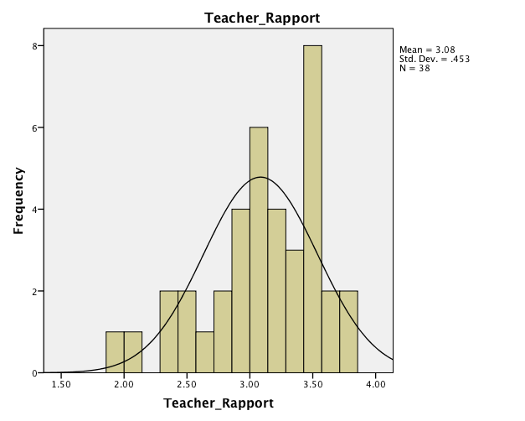
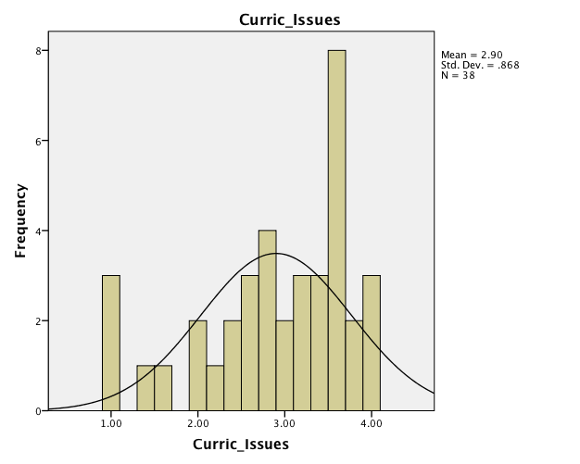
Teacher Rapport / Curriculum Issues

Slide 19
Findings
LPI total & PTO total strong correlation r= .638
Individual dimension scores of the PTO and the LPI demonstrated an appropriate amount of variability across the possible range of scores
Distributional characteristics suggests that all of the variables had slight to moderate negative skew

Slide 20
Quantitative Data Analysis
r = .638

Slide 21
Implications
Theoretical implications
The research by Marzano et al. (2005) and Cotton (2003) focused on specific leadership behaviors related to student growth.
Transformational Leadership supports the significance defined by factor 1 of the PTO: Teacher Rapport with Principal.
Practical implications
Principal preparation programs need to use the research and the theories of leadership to train their future principals in the areas that affect teacher morale.
Future implications
Principals need to use the knowledge to self-assess their daily practices and gain knowledge on how they help or hurt the morale of their teachers.

Slide 22
Conclusions
Teacher rapport was strongest among all relationships between the dimensions of the LPI and PTO
The responses to teacher rapport were very consistent yielding a
r= .885 correlation.
Importance for new principals to prioritize building relationships with their teachers.
Interpersonal skills are strongly linked to the perception of leadership
Teacher load, curriculum issues and school facilities and services are not as strongly connected with the perception of leadership.

Slide 23
Recommendations
Future Research:
Expand the research to all states in the North East
Include a qualitative aspect
Practice:
Increase geographic area
Focus on human relationships

Slide 24
Feedback & Questions
I want to express my gratitude to the
Dissertation committee members.
Thank you!

Slide 25
References
Ash, R. C., Hodge, P. H., & Connell, P.H. (2013) The recruitment and selection of principals who increase student learning. Education, 134(1), 94-100.
Beaudoin, M.N. (2011) Respect. Educational Leadership. September, 40- 44.
Bentley, R. R., & Rempel, A. M. (1980). Manual for the Purdue Teacher Opinionaire. West Lafayette, IN: Purdue Research Foundation.
Briggs, L. D., & Richardson, W. D. (1992) Causes and effects of low morale among secondary teachers. Journal of Instructional Psychology, 19(2), 87.
Cotton, K. (2003) Principals and Student Achievement. Assoc. for Supervision & Curriculum Development. Alexandria, VA.
Evers, R. & Jean, C. (2011) A relational study of elementary principals’ leadership traits, teacher morale, and school performance. (Doctoral dissertation). The University of Southern Mississippi, Hattiesburg, MI.
Fuller, E.J. & Young, M.D. (2008). The revolving door: principal turnover in Texas. Texas Study of Secondary Education, 17(2): 14-18.
Goodwin, B. (2013) A principal’s success requires people skills. Educational Leadership. 79-80.
Hong, J. (2012) Why do some beginning teachers leave the school, and others stay? Understanding teacher resilience through psychological lenses. Teachers & Teaching, 18(4), 417-440.
Houchard M.A. (2005). Principal Leadership, teacher morale, and student achievement in seven schools in Mitchell County, North Carolina. Unpublished doctoral dissertation, University of East Tennessee State, East Tennessee State. (UMI No. 3195375).
Hunter-Boykin, H. S., Evans, V. (1995). The relationship between high school principals’ leadership and teachers’ morale. Journal of Instructional Psychology, 22(2). 152- 162. Retrieved November 15, 2013, from Academic Search Premier Database.
Kersaint, G., Lewis, J., Potter, R., & Meisels, G. (2007) Why teacher leave: factors that influence retention and resignation. Teachers & Teaching Education, 23(6), 775-794.
Kouzes, J. M., & Posner, B. Z. (2002b). The Leadership Practices Inventory: Theory and Evidence behind the Five Practices of Exemplary Leaders. Retrieved March 5, 2013, from http://media.wiley.com/assets/463/74/lc_jb_appendix.pdf
Liu, X. S., & Meyer, J. P. (2005). Teachers' perceptions of their jobs: A multilevel analysis of the teacher follow-up survey for 1994–95. Teachers College Record, 107(5), 985-1003. Retrieved November 15, 2013, from Academic Search Premier Database.
Marston, S.H. (2010) Why do they teacher? A comparison of elementary, high school, and college teachers. Education, 131 (2), 437-454.
Mendels, P., & Mitgang, L. D. (2013) Creating strong principals. Educational Leadership, 70(7), 22-29.
Meyer, M., Macmillam, R. & Northfield, S. (2009) Principal succession and its impact on teacher morale. International Journal of Leadership in Education. 12(2), 171-185.
Norton, M. (2002). Let’s keep our quality school principals on the job. High School Journal, 86(2), 50.
The Wallace Foundation. (2004) Review of research: How leadership influences student learning. January, 1-88.
U.S. Department of Education (2005) Teacher attrition and mobility rates from 2004-2005. Teacher follow-up survey, 7-9.

